Slide 1

Nasty, Filthy Datases
Kelli McKeegan
BIOL 792: Data Science for Biology II
Spring 2021
A tale told with the aid of imagery from Peter Jackson’s adaptation of The Lord of the Rings

Slide 2
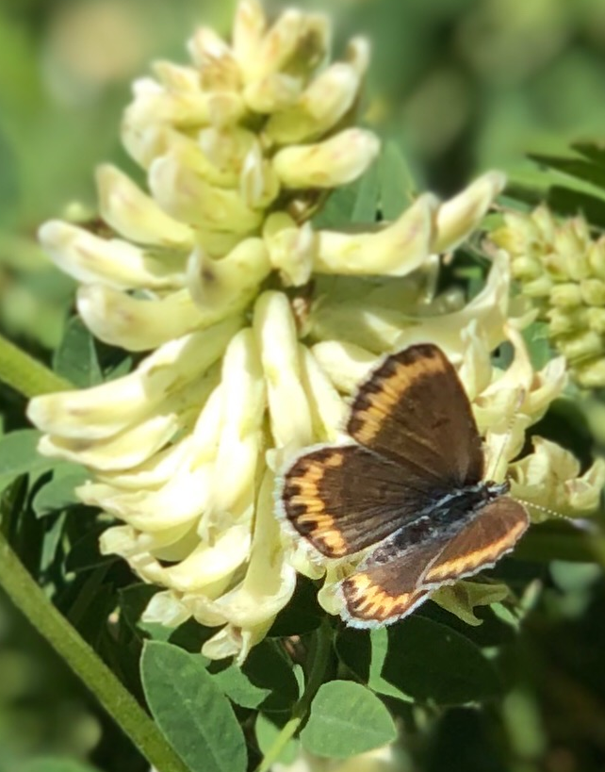
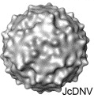
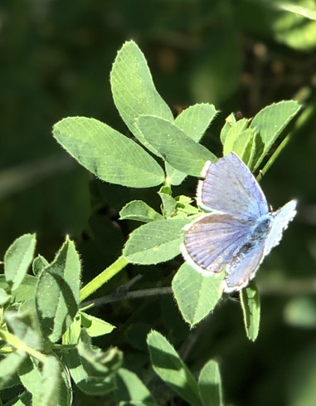
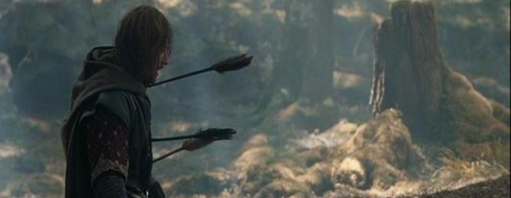
Research Background
VIRUS
Junonia coenia densovirus (JcDV)
Rivers & Longworth, 1972: common buckeye (Lepidoptera: Nymphalidae)
Parvoviridae: small, non-enveloped, ssDNA
Genes: capsid protein & non-structural
Contracted orally
Replicates in epidermis & tracheal tissue
Affects molting & respiration
HOST
Melissa blue butterfly (Lycaeides melissa)
Lepidoptera: Lycaenidae
Range: western North America
Non-migratory, multivoltine
Sexually dimorphic
Ant-tended
Host plant family: Fabaceae
Native: Astragalus, Glycyrrhiza, Lupinus spp.
Recent novel: Medicago sativa

Slide 3
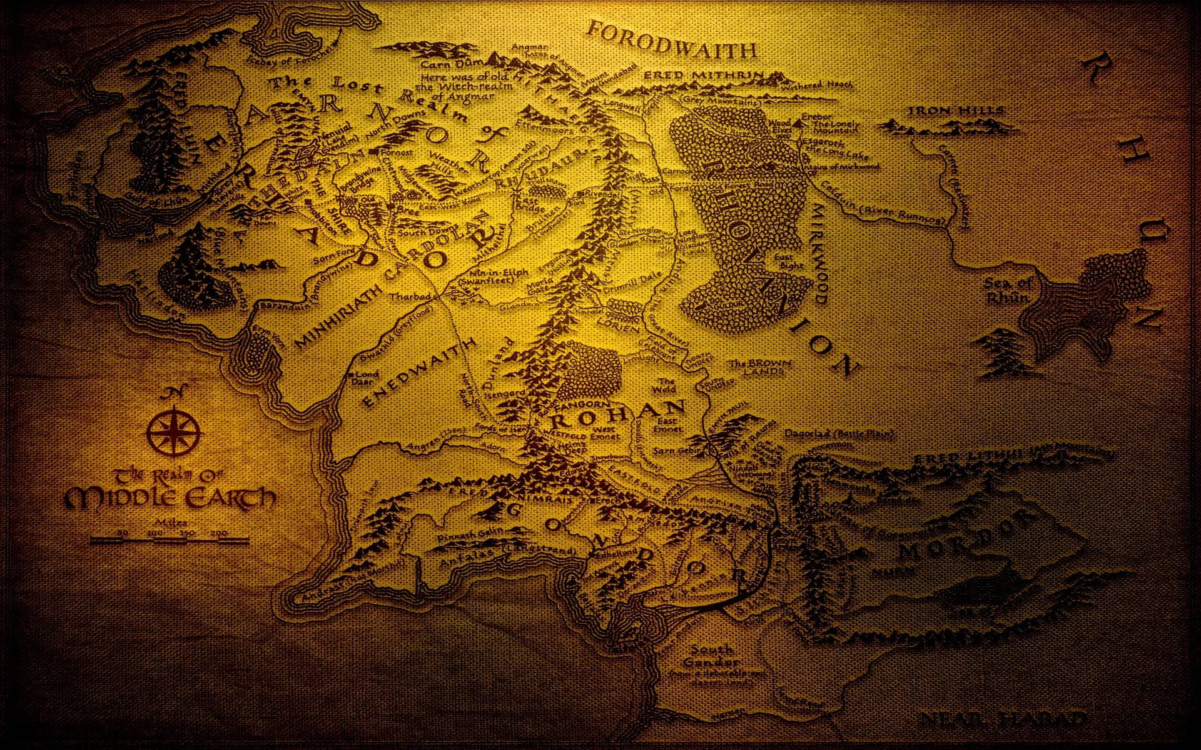

Questions
Where and in what amount does JcDV exist in wild L. melissa communities?
Plants, soil, ants, treehoppers
L. melissa adults & larvae
How does JcDV disperse and spread amongst hosts?
Does it infect other orders of insects?
Is it carried from surface to surface?

Slide 4
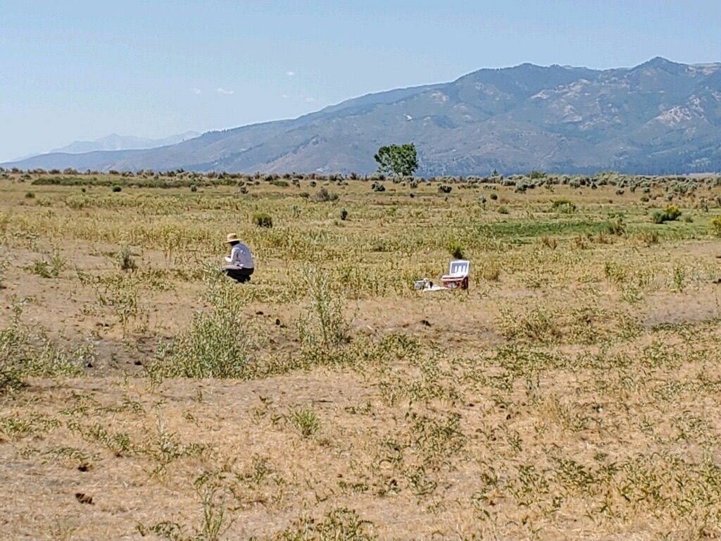
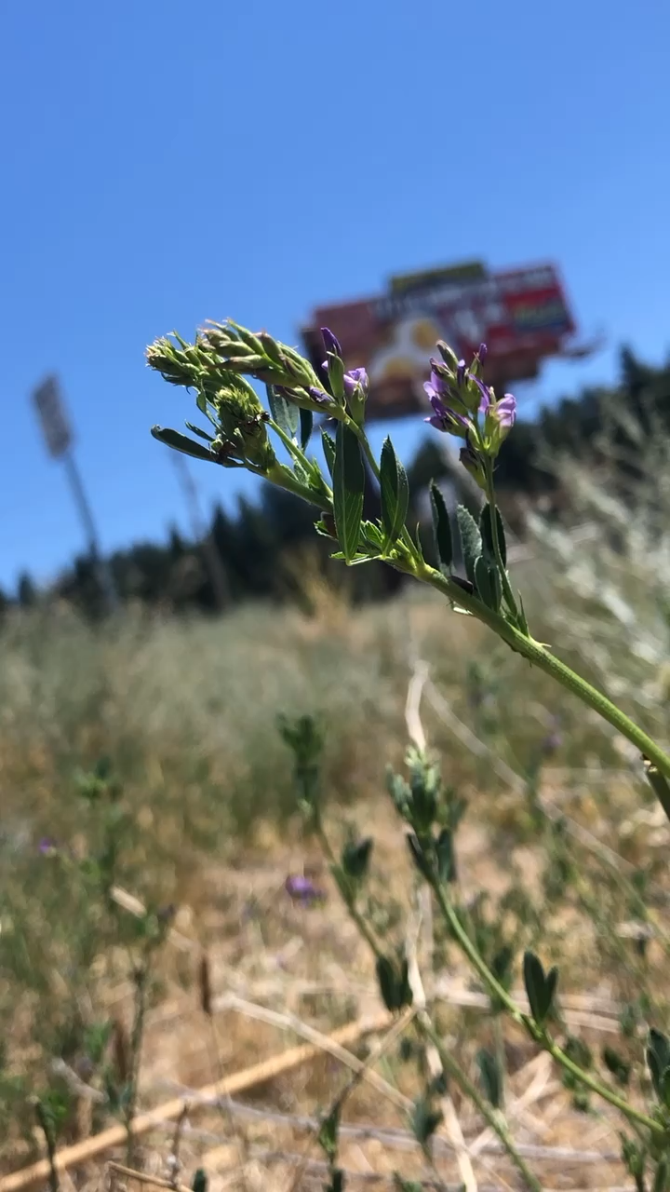
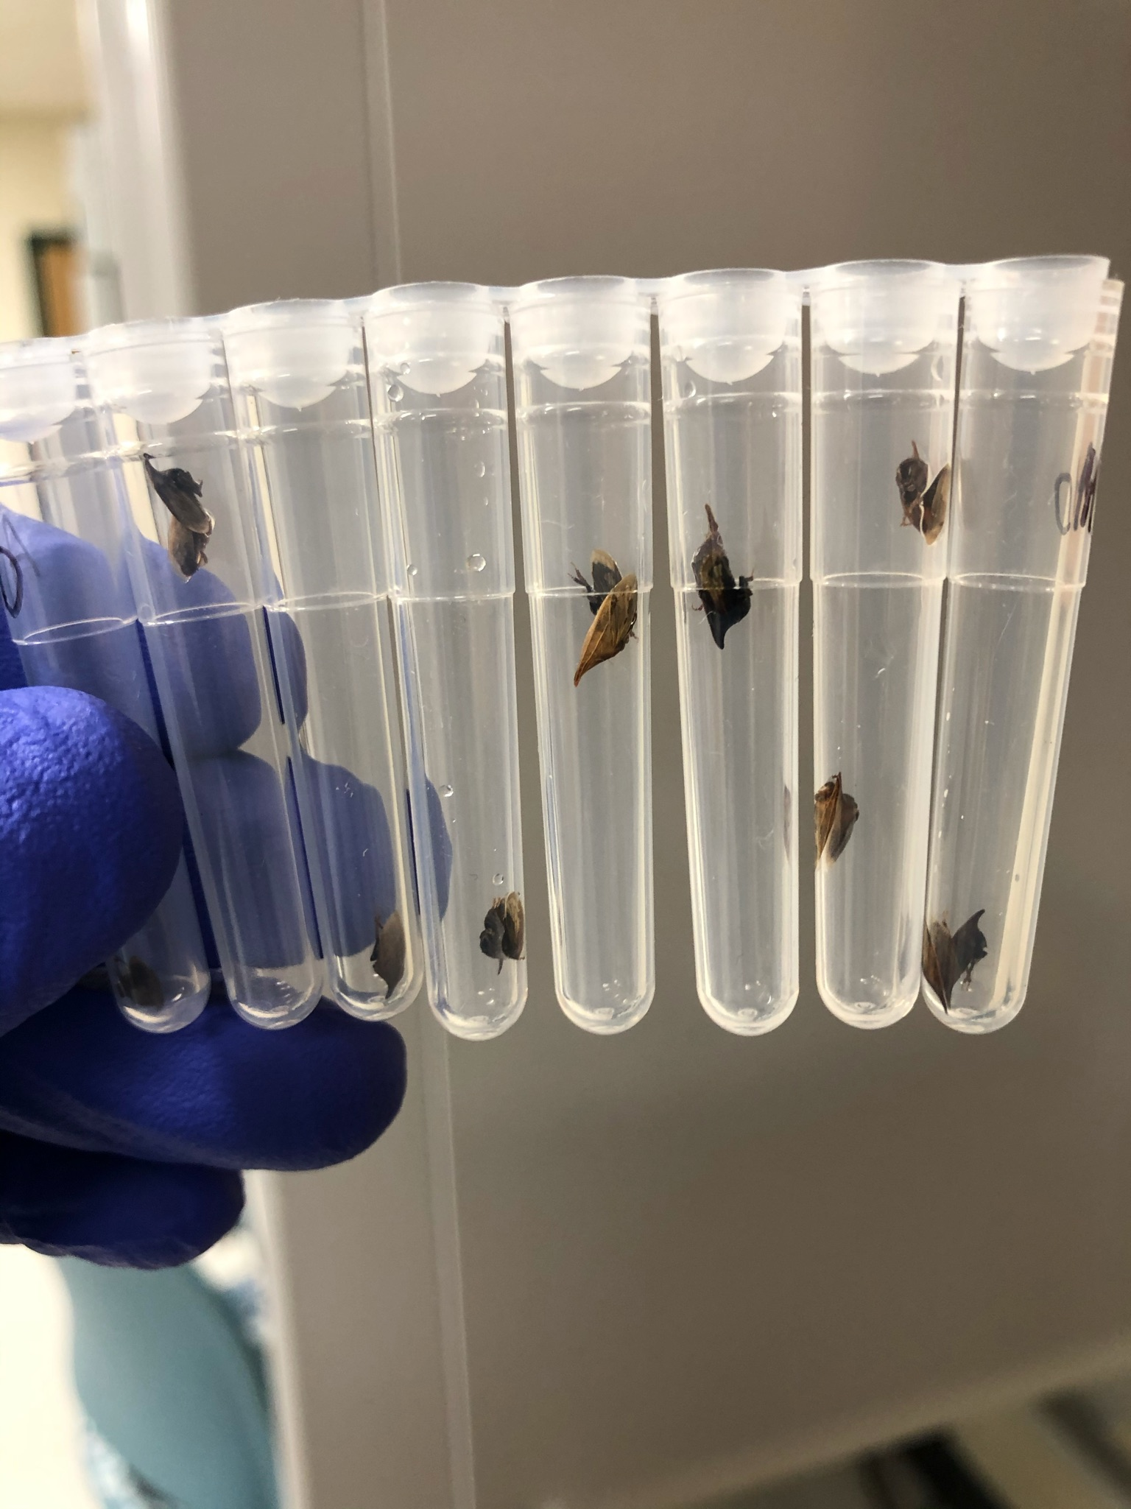
Community Pool Samples: Summer 2020
26 populations
Mixture of native & novel plants
Weather aspects
Adult L. melissa
Randomized plant samples
Different parts of plants
Soil from underneath
If found on plant: ants, treehoppers, L. melissa larvae
Repeat sampling (3-4x) at 4 sites over flying season

Slide 5
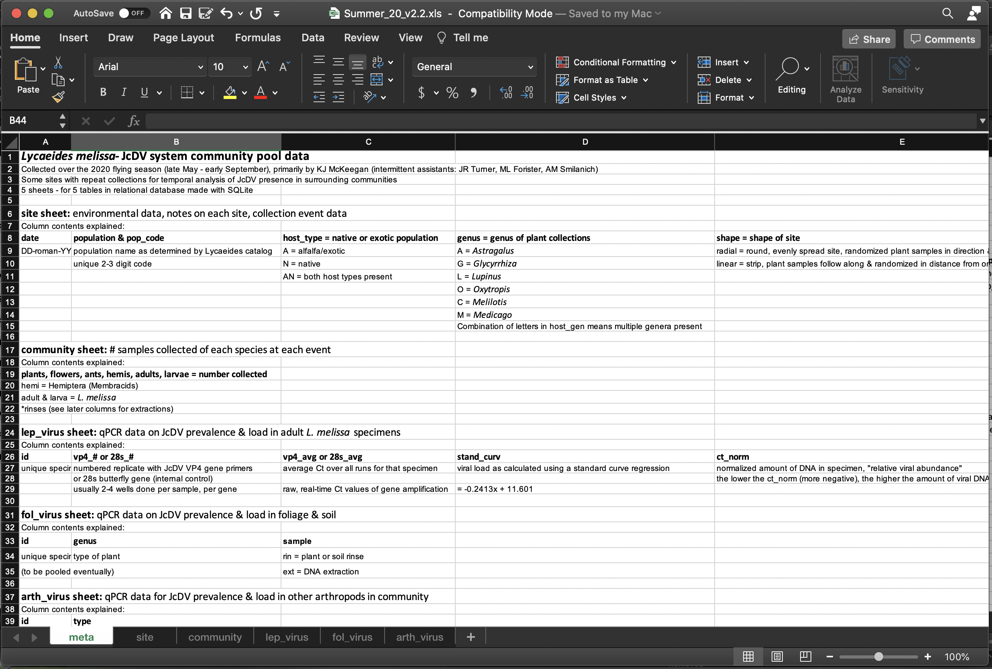

Metadata (and Version Control)

Slide 6

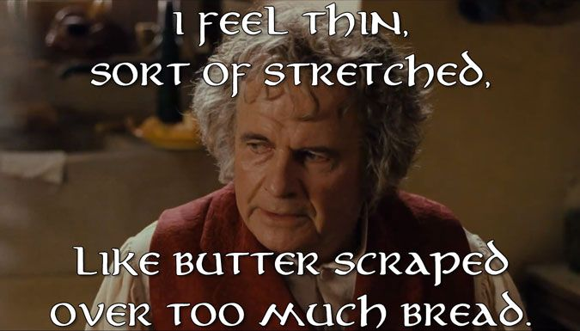
The Problem
Raw, wide data (30+ columns)
Screened with qPCR, so columns for:
Each replicate
Average
Calculation for standard curve regression (load)
Inconsistencies
Set up for failure once individual specimens get IDed

Slide 7
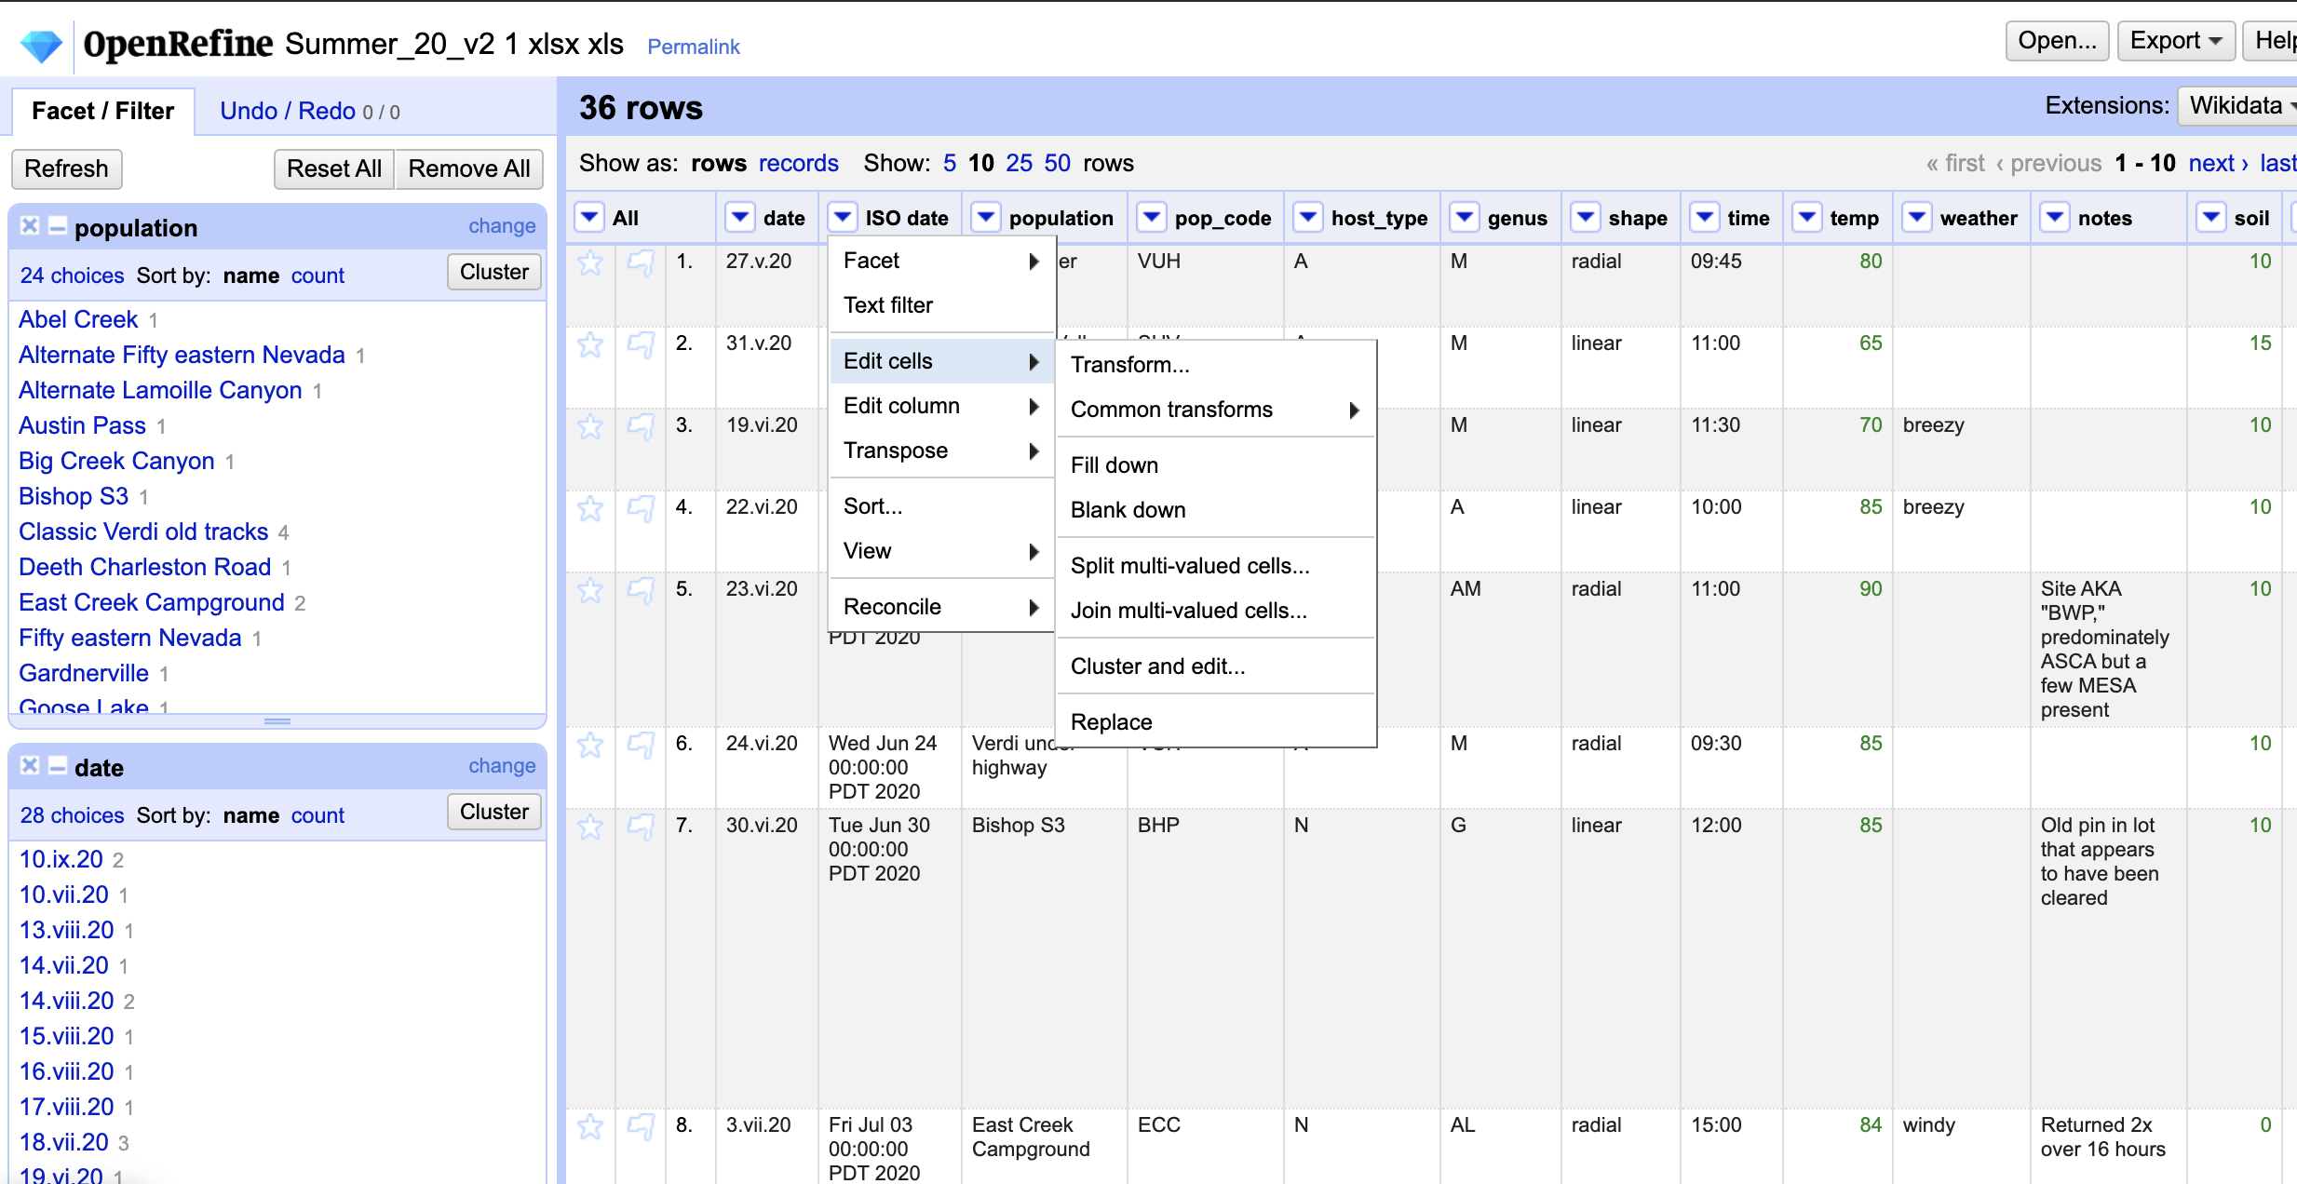
The Solution: Clean it up
OpenRefine
Great for future long-term collections!!!
Corrected mistakes
Consistency
Date formats
Finding totals:
Unique populations
Visits
Collections

Slide 8
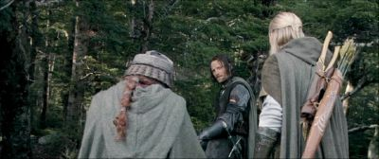
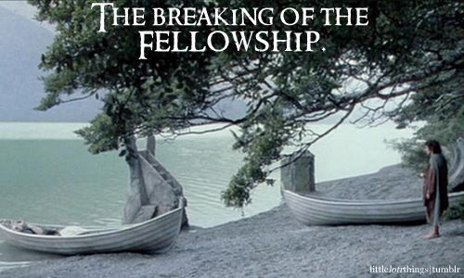
The Solution: Split it up
Multiple tabs (“tables”)
Collection event data
Site data
Community pool collections
qPCR for each kind of specimen:
L. Melissa
Plants (rinses & extractions)
Other arthropods: Ants, Membracidae
Design a relational database: SQLite
Eventual analyses in this format

Slide 9

Relational Database Structure
event
ISO_date
pop_code
time
temp
weather
site_notes
date
text
text
text
text
text
arth_virus
lep_virus
ISO_date
pop_code
host_type
type
id
vp4_1
vp4_2
avg
load
prev
date
text
Boolean
text
text
real
real
json
json
json
ISO_date
pop_code
host_type
id
sex
28s_1
28s_2
28s_avg
vp4_1
vp4_2
avg
load
ct_norm
prev
date
text
Boolean
text
Boolean
real
real
json
real
real
json
json
json
json
fol_virus
community
ISO_date
pop_code
host_type
genus
id
vp4_1
vp4_2
avg
load
prev
date
text
Boolean
text
text
real
real
json
json
json
ISO_date
pop_code
host_type
soil
plants
flowers
ants
hemis
adults
larvae
sample_notes
date
text
Boolean
integer
integer
integer
integer
integer
integer
integer
text
site
date
ISO_date
population
pop_code
host_type
genus
shape
site_notes
blob
date
text
text
Boolean
text
text
text

Slide 10
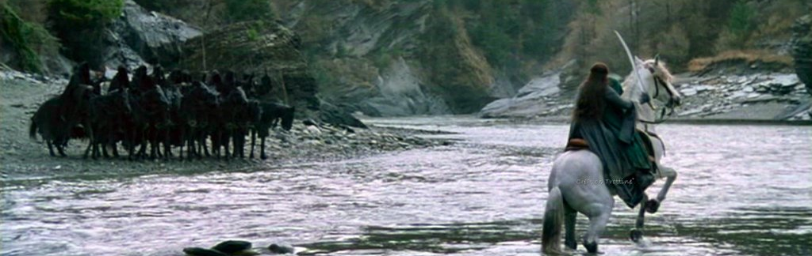
The road goes ever on and on…
What I learned:
Data cleaning, manipulation, management
How to use OpenRefine & SQLite
Existence of relational databases
How to structure them
Nice ways to record data real-time
Some goals for the future:
Finish collecting data (qPCR)
Keep it clean for others
Continue using SQLite!
Julian date, average, load
Data analyses

